Slide 1



Slide 2


Slide 3

Reproduction
The formation of new living things is called reproduction. This is one of the characteristics of living things. There are two types of reproduction, asexual and sexual:
Asexual reproduction is the formation of living things from one parent only
Sexual reproduction is the production of living things by combining cells from two parents.
Asexual reproduction
Asexual reproduction happens when one cell splits into two, or when one organism divides to form two or more living things. Asexual reproduction does not require sex cells to join together.
In asexual reproduction the offspring are identical to the parent cell or cells.

Slide 4
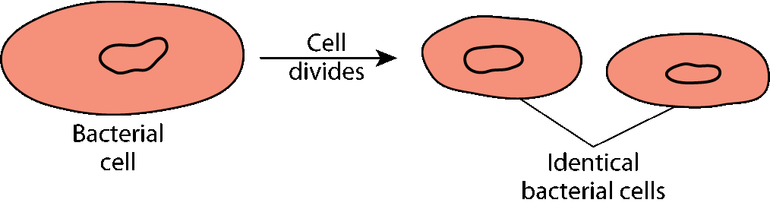
Reproduction
Examples of asexual reproduction
(a) Bacteria are single-celled organisms. When they divide they form two identical cells.
Asexual cell division

Slide 5
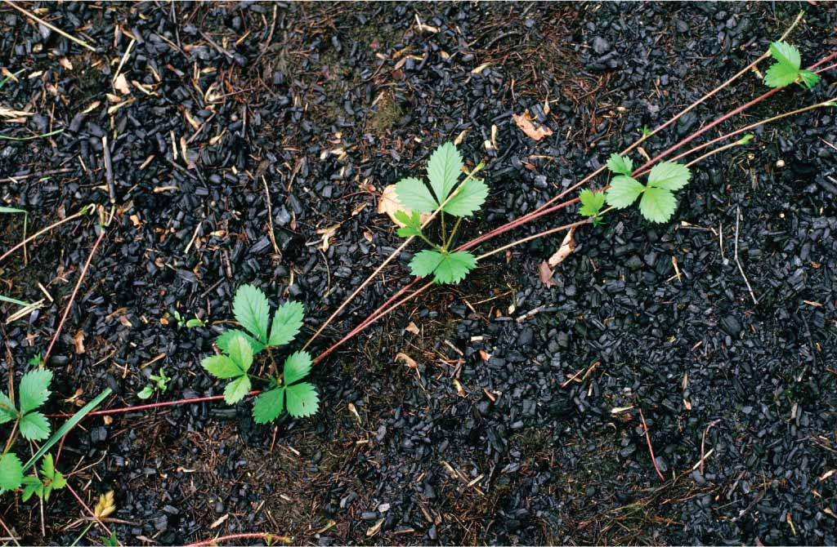
Reproduction
Examples of asexual reproduction
(b) Strawberry (and buttercup) plants produce special stems (called runners), which grow overground from the base of the parent plant.
Some distance away from the parent plant, the runners form new plants, which are identical to the parent plant.
Strawberry plant with runners

Slide 6
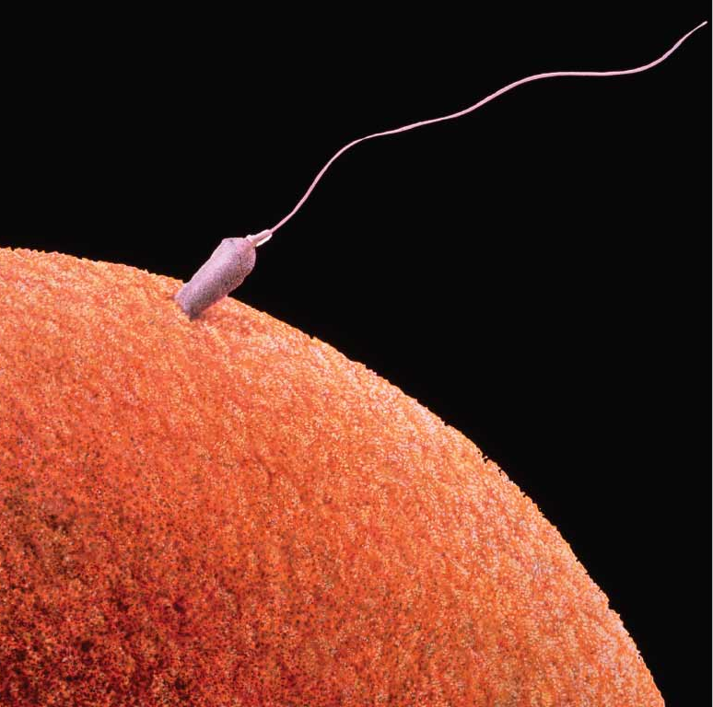
Sexual reproduction
A gamete is a sex cell.
Sexual reproduction involves two sex cells (or gametes) joining together to form a single cell (called a zygote).
Fertilisation is the joining or fusion of sex cells. As a result of sexual reproduction the offspring formed have features or characteristics of both parents. This means the offspring are not identical to the parents. This is the main benefit of sexual reproduction.
The most common way animals reproduce is by sexual reproduction (see chapter 11). Plants can reproduce sexually or asexually.

Slide 7
Passing on characteristics
Characteristics are traits or features of an organism that can be passed on from parents to their offspring. Characteristics are controlled by genes (which are found on chromosomes).
Genes are passed from parents to their offspring during reproduction.
In asexual reproduction the parent passes exact copies of its genes to the offspring. This is why the offspring are genetically identical to the parent. For example, strawberries that reproduce by runners will taste, look and grow the same as the strawberries on the parent plant.
In sexual reproduction the offspring have different genes.

Slide 8

Examples of characteristics
Humans have many genetically controlled characteristics. These include:
Eye colour
The presence or absence of freckles
Having two eyes
Having one heart
The ability to roll the tongue.
Plant characteristics controlled by genes include:
Colour of the fruit
Colour of the petals
Taste of the fruit
Height of the plants.

Slide 9
Variation
Humans have many characteristics in common. They have one heart, two eyes and the ability to produce chemicals such as saliva, sweat and hair.
However, humans also have some differences (or variation). There are two types of variation:
Genetic (inherited)
Non-inherited (acquired).
Genetic variation is differences passed on from parents to their children by genes. This means that genetic variation is inherited from the parents. For example, eye colour, the length of our eyelashes and the presence or absence of freckles are all inherited from our parents.
Non-inherited variation is differences that are not controlled by genes. These variations do not pass from parents to their children. They have to be learned or practised. For example, speaking a language, using a computer, reading or tying a lace are non-inherited variations.

Slide 10
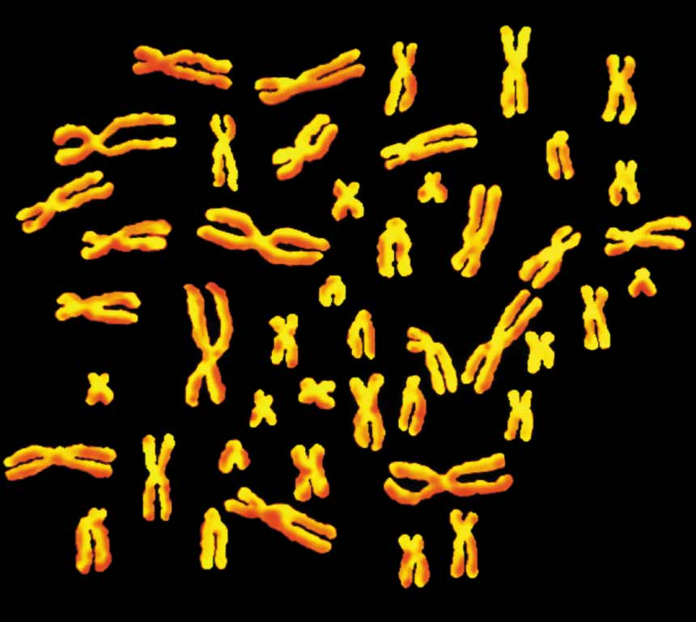
Chromosomes and genes
Chromosomes are thread-like structures found in the nucleus of each plant and animal cell.
Most of the time chromosomes cannot be seen in a nucleus because they are stretched out into extremely long, thin threads. Most human cells have 46 chromosomes.
The 46 chromosomes from a human cell
Notes:
The picture and its description were on slide from start – added animation

Slide 11
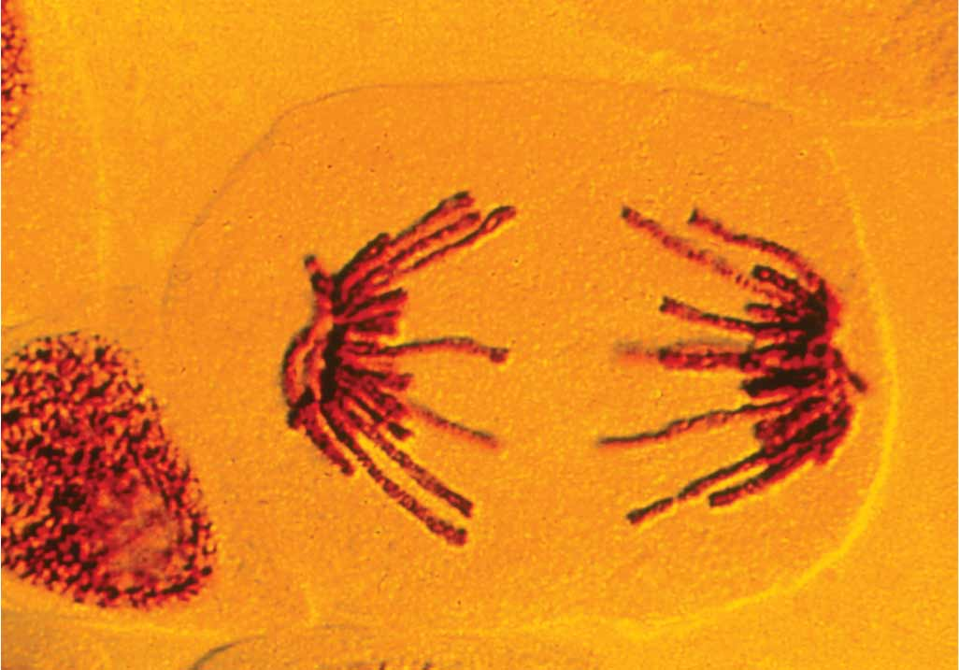
Chromosomes and genes
When cells divide, the chromosomes become shorter and thicker and can be seen using a microscope. At this time each chromosome looks like a tiny, thin thread. Chromosomes are made of a chemical called deoxyribonucleic acid (DNA) and protein.
A dividing cell showing chromosomes
Genes are short sections of DNA located on chromosomes. Genes control the production of inherited characteristics. Examples of human genes include:
The gene to make acid in our stomach
The gene to make the coloured chemical (pigment) in our eyes.

Slide 12
Patterns of inheritance
The inheritance of genetic characteristics often follows a pattern. This is because of the way in which genes may be inherited from each parent. The pattern of inheritance is best understood by following the outcomes of sample genetic crosses.
Genes
Chromosome

Slide 13
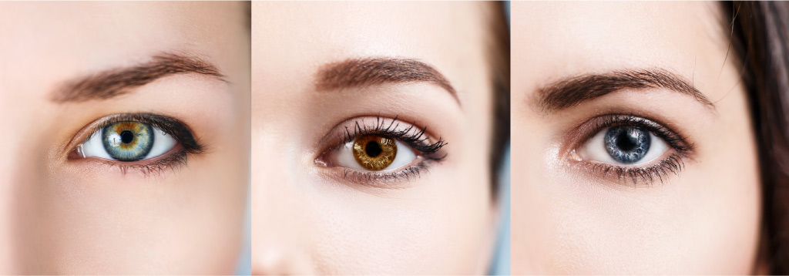
Introduction to genetic crosses
Eye colour in humans is controlled by a gene. The gene has two versions:
The dominant version, represented as B, causes brown eyes
The non-dominant version (also called the recessive version), represented as b, causes blue eyes.
This information is often shown as:
B = brown eyes (dominant)
b = blue eyes (recessive).
Notes:
Moved picture animation to earlier stage

Slide 14
Introduction to genetic crosses
Normally the first letter of the dominant version is used; e.g. for brown eyes, B is used.
The dominant version prevents the recessive version of the gene from working.
Genotype is the genes an organism possesses.
In terms of eye colour, each person has two copies of the gene. This means they may have the following combinations:
Gene version (or genotype) | Eye colour
BB | Brown eyes
Bb | Brown eyes
bb | Blue eyes

Slide 15
Introduction to genetic crosses
Phenotype is what the organism looks like. For example, the eye colour is the phenotype.
In sexual reproduction the number of genes is halved during the production of the gametes (sperm and eggs, also known as sex cells). This means the gametes each contain only one version of the gene.
A person with the combination… | Will produce gametes (or sex cells) with …
BB | a single B
Bb | either B or b
bb | a single b

Slide 16
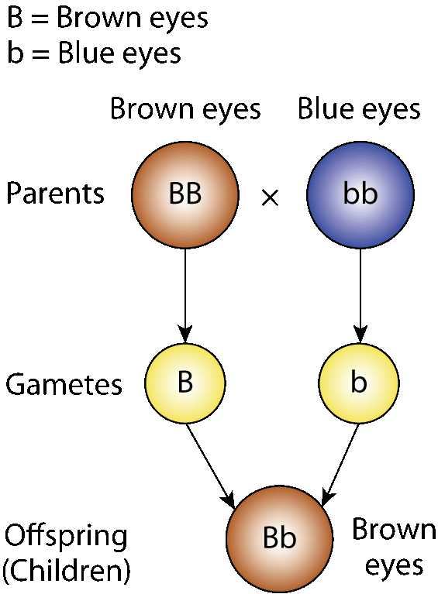
Genetic crosses
Cross 1
Question
Show the pattern in eye colour of a family in which one parent is BB and the second parent is bb.
Answer
In this case all the children will have brown eyes.

Slide 17
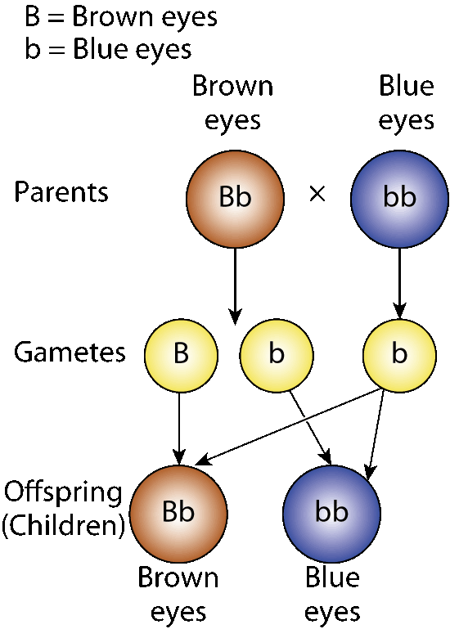
Genetic crosses
Cross 2
Question
Show the pattern of inheritance in eye colour in the following family: a brown-eyed parent who is Bb and a blue-eyed parent.
Answer

Slide 18
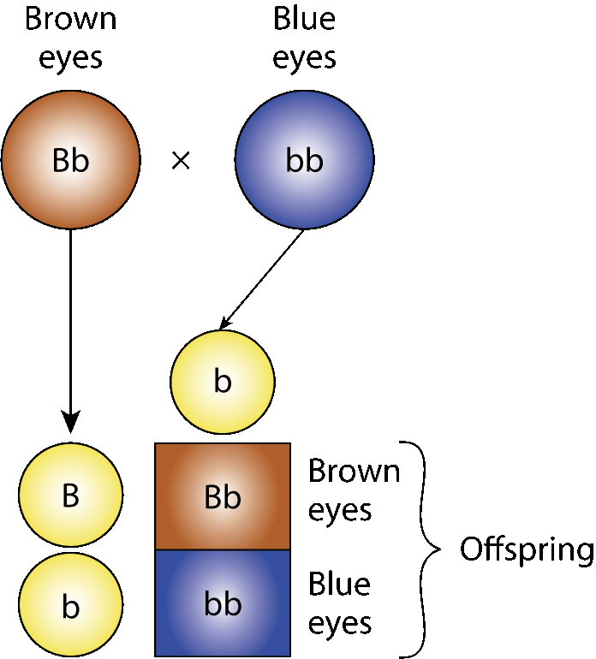
Genetic crosses
Cross 2
Cross 2 can also be shown using a Punnett square.
In this cross there is an equal chance of a brown-eyed or a blue-eyed child. In other words, there is a 50% (or 1 in 2) chance of a brown-eyed or a blue-eyed child.

Slide 19
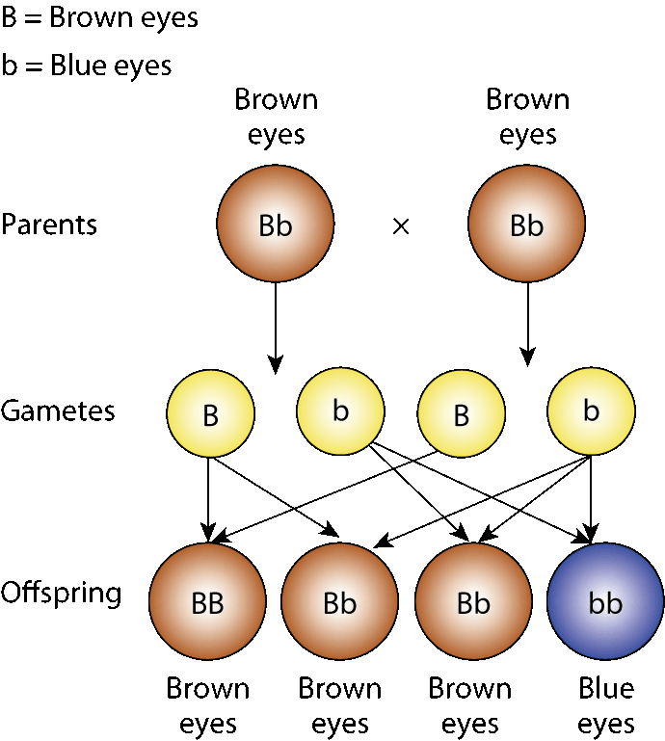
Genetic crosses
Cross 3
Question
Show by diagrams the pattern of inheritance in eye colour for a family in which both parents are brown-eyed (Bb). From the cross predict the percentage chance of the couple having a blue-eyed child.
Answer

Slide 20
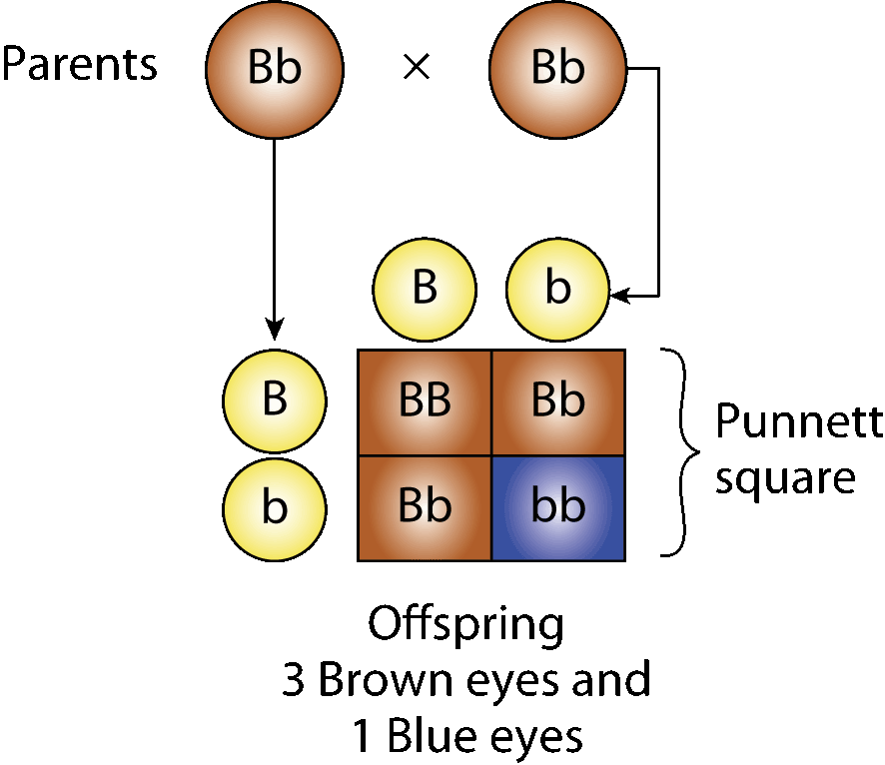
Genetic crosses
Cross 3
Cross 3 can also be shown as:
In this cross there is a 25% (or 1 in 4) chance of the couple having a blue-eyed child.

Slide 21
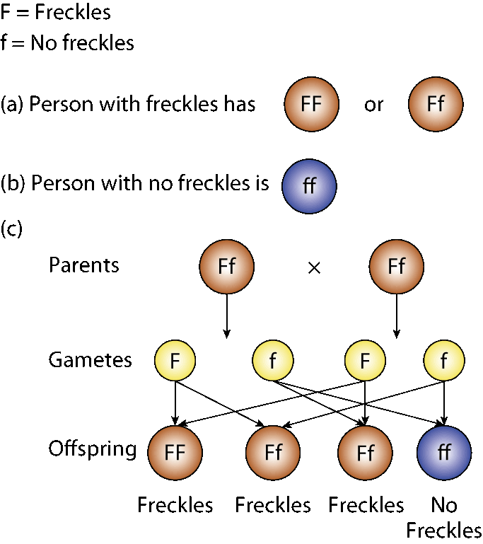
Genetic crosses
Cross 4
Question
Freckles are caused by the dominant version of a gene (F). Lack of freckles is caused by the recessive version of the gene (f).
(a) Which two of the following genetic combinations could a person with freckles have?
FF Ff ff
(b) What genetic combination must a person with no freckles have?
(c) If a couple are both Ff, what is the chance of them having a child with freckles? Explain your answer by showing the genetic cross.
The chance of this couple having a child with freckles is 75% (or 3:1). The same result would be obtained if this cross were drawn as a Punnett square.

Slide 22
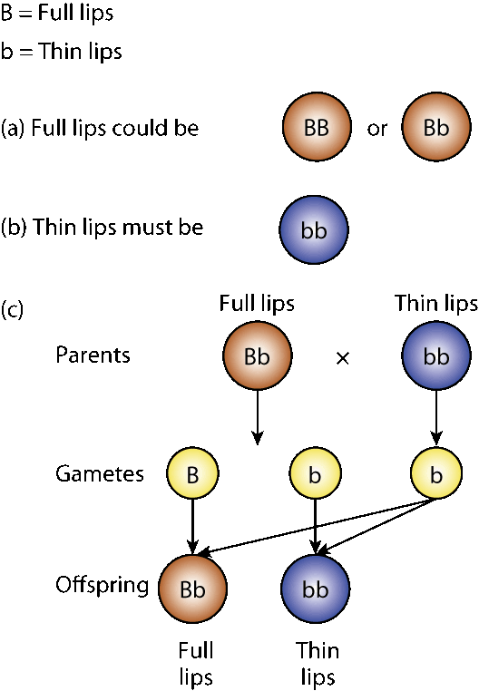
Genetic crosses
Cross 5
Question
Full lips (B) are dominant to thin lips (b). A couple, one with full lips and the other with thin lips, have two children. One of the children has full lips and the other has thin lips.
(a) What are the two possible genetic combinations of a person with full lips?
(b) Only one genetic combination produces thin lips. What is this combination?
(c) Show by diagrams how the pattern of inheritance of the couple and their children could occur.

Slide 23
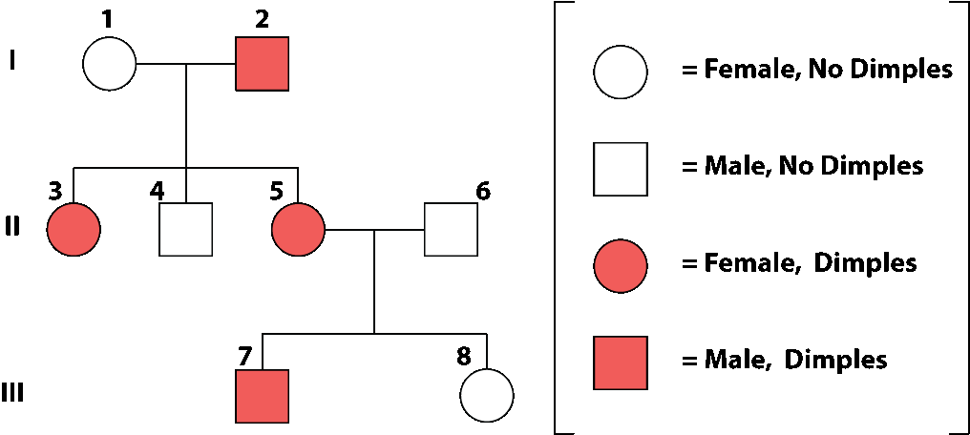
Pedigree studies
A pedigree chart is a diagram showing the physical appearances of individuals in a family from one generation to the next. Below is an example of a pedigree chart (also called a family tree).

Slide 24
Pedigree studies
In a pedigree chart:
A circle ( ) represents a female; a square ( ) represents a male
A solid symbol represents an affected individual; an empty symbol represents an unaffected individual
Roman numerals (I, II, III, etc.) represent the different generations
Simple numbers or digits (1, 2, 3, etc.) represent individuals
A horizontal line represents a couple that have offspring
A vertical line links parents to offspring.
Notes:
Moved picture animation at top of list to appear before text

Slide 25
Pedigree studies
Figure 3.15 represents the appearance of dimples in a family. No dimples (D) is dominant to dimples (d).
The diagram shows three generations of a family (I, II, III). The parents are numbered 1 and 2.
Notes:
Moved picture animation at top of list to appear before text

Slide 26
Pedigree studies
Person 1 is a female who does not have dimples. Person 2 is a male with dimples.
Their three children are numbered 3, 4 and 5. Both daughters (numbered 3 and 5) have dimples but their son (4) does not have dimples.
Persons 5 and 6 have two children (7 and 8). Person 7 is a male with dimples, person 8 is a female with no dimples.
Notes:
Moved picture animation at top of list to appear before text

Slide 27
Photo credits
Shutterstock
Michael Philips
Compuscript
Science Photo Library

